Slide 1

SonarQube Developer Training

Slide 2
Presenter: Paul Steele
Sonarqube Implementation & Support – Team Lead
Enterprise Quality Tools
paul.steele@optum.com
Sonarqube Team Members
Paul Steele
Ramya Radhakrishnan
Ryan Gurbatri
Himanshu Sharma
Adam Oldakowski
Frank Sanchelli
Team email address:
sonar@optum.com

Slide 3
History
SonarQube history at Optum
SonarQube has been around in Optum for 3 years
Fully implemented in the PEDS business area
Planned to be rolled out to all applications across 3 key technologies - .NET, JAVA, Mainframe.
Fully licensed and supported version – Zero charge back or license fee for applications
Key Part of our DevOps Strategy
Enabler to enforcing code quality concepts in a TRANSPARENT, MEASURABLE & REPEATABLE way.
Notes:
Waqar to update this slide with content notes:
History
Number

Slide 4
SECURITY_FEATURES
INPUT_VALIDATION_AND_REPRESENTATION
API_ABUSE
SECURITY_COMPLIANCE
ERRORS
What is Code Quality?
Quality & Rules Categories
SonarQube Quality Characteristics & Associated Rules
Security (Production Impact)
Changeability (Reduce cost & time to market)
Maintainability (Reduce cost & time to market)
Reliability (Production Impact)
Efficiency (Production Impact)
Portability (Reduce cost & time to market)
Reusability (Reduce cost & time to market)
Testability (Reduce cost & time to market)
LOGIC_RELIABILITY
DATA_RELIABILITY
INSTRUCTION_RELIABILITY
SYNCHRONIZATION_RELIABILITY
ARCHITECTURE_RELIABILITY
EXCEPTION_HANDLING
RESOURCE_RELIABILITY
FAULT_TOLERANCE
UNIT_TESTS
ARCHITECTURE_CHANGEABILITY
DATA_CHANGEABILITY
LOGIC_CHANGEABILITY
CPU_EFFICIENCY
MEMORY_EFFICIENCY
UNDERSTANDABILITY
READABILITY
MAINTAINABILITY_COMPLIANCE
LANGUAGE_RELATED_PORTABILITY
SOFTWARE_RELATED_PORTABILITY
OS_RELATED_PORTABILITY
HARDWARE_RELATED_PORTABILITY
COMPILER_RELATED_PORTABILITY
UNIT_TESTABILITY
MODULARITY
Notes:
Waqar to update this slide with content notes: What the focus Industry idea of Quality or SQ scope?

Slide 5
SonarQube Overview
What is SonarQube
Drives “Code Quality” based on a defined set of rules
These rules are based on industry established coding standards
Enables issues identification and correction during the development phase
Applications are added to SonarQube through the “build” process with results download to SQ

Slide 6
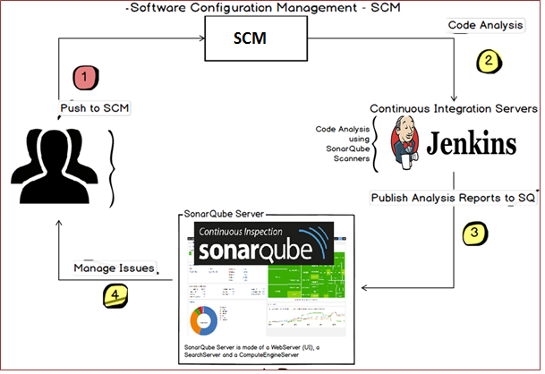
SonarQube Integration with CICD
Notes:
Agile vs Waterfall, SQ can work for both methodologies

Slide 7
Quality Gates
Quality Gates are predefined levels of quality that applications are measured against.
Quality Gates are defined based on…
Level of severity (Blockers, Criticals, Majors, Minors, Info)
Percentage of lines covered by successful unit test cases,
This Gate criteria is applied against
New lines of code
All lines of code.
Quality Gates are tied to your Jenkins build process. Your build will fail and you won’t be allowed to move your code to production if your code’s quality does not meet the quality gate’s criteria.
As your application’s quality improves over time it is automatically promoted to higher gates.

Slide 8
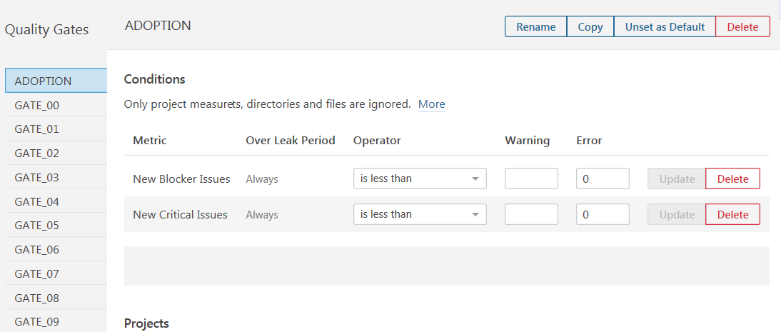
Quality Gates Example – Adoption level
The Adoption level is the lowest level gate. All new projects are assigned to the Adoption level for their first scan.
In this example the Adoption gate looks at the two highest severities (Blocker and Critical) and only new lines of code, meaning they’ve been added following the first scan.

Slide 9
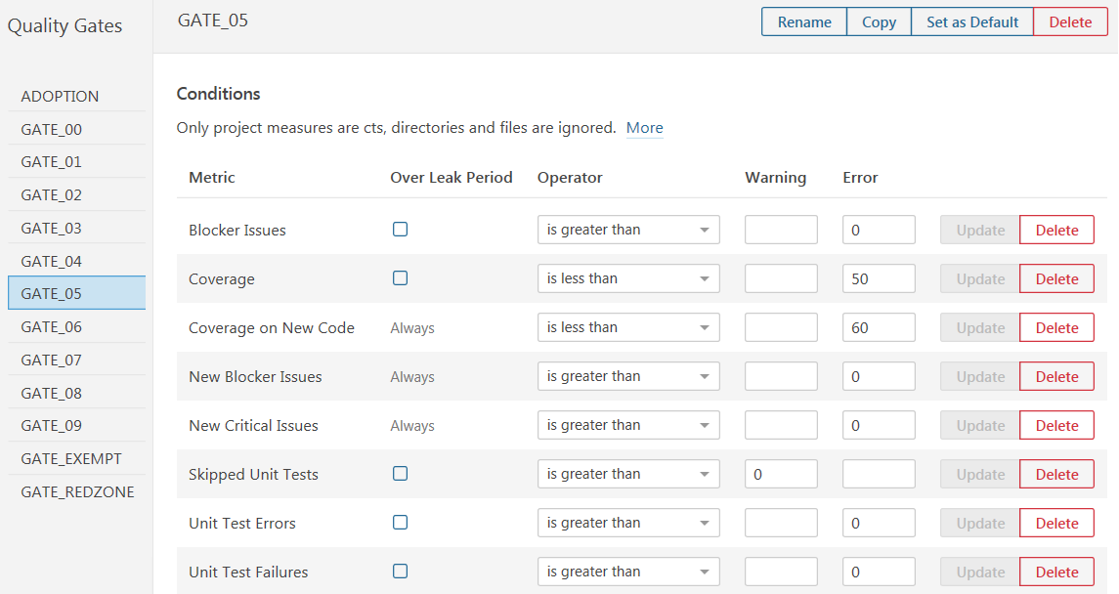
Quality Gates Example – Gate 05
In this example Gate 5 also looks at the two highest severities but now it’s looking across all code. Also, it’s looking at Unit Test Coverage. At Gate 05 the scan is looking for number of lines of code covered by unit tests for new code and across all code.

Slide 10
Names/Keys - (Set in your Jenkins or TFS Job)
Name
The Name field is used on screens and reports. The field should always try to mirror with ASK Application “Formal Name” field. (Use the ASK Application List Report to find your applications “Formal Name”.)
Mainline example: “Provider Online”
Dev Branch example: “Provider Online DB1”
Key
– (uniquely identifier)
Standard format: “com.optum.[program]:[application]”.
Mainline: “com.optum.provider_portal:provider_online”
Dev Branch “com.optum. provider_portal:provider_online:db1”
Notes:
Application as a Project
Application as a View

Slide 11
Begin Online Screens Tutorial
http://sonar.optum.com/
Login: msid / ms-password

Slide 12
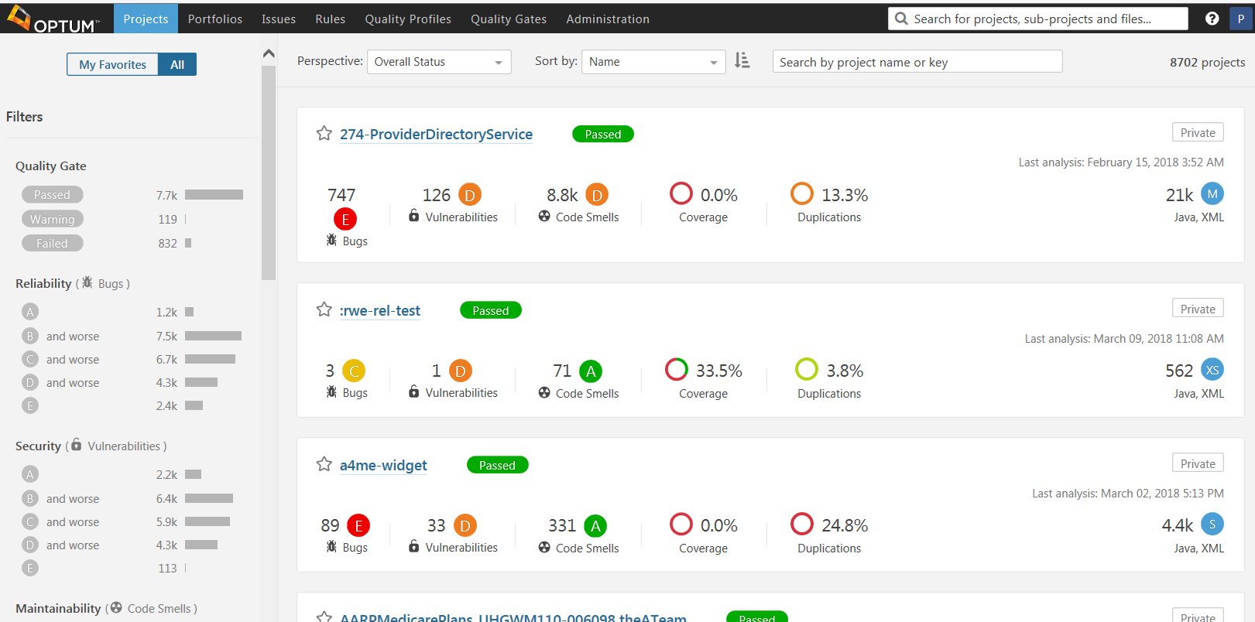
Sonarqube Dashboard
To find for a specific application enter your criteria in the Search field

Slide 13
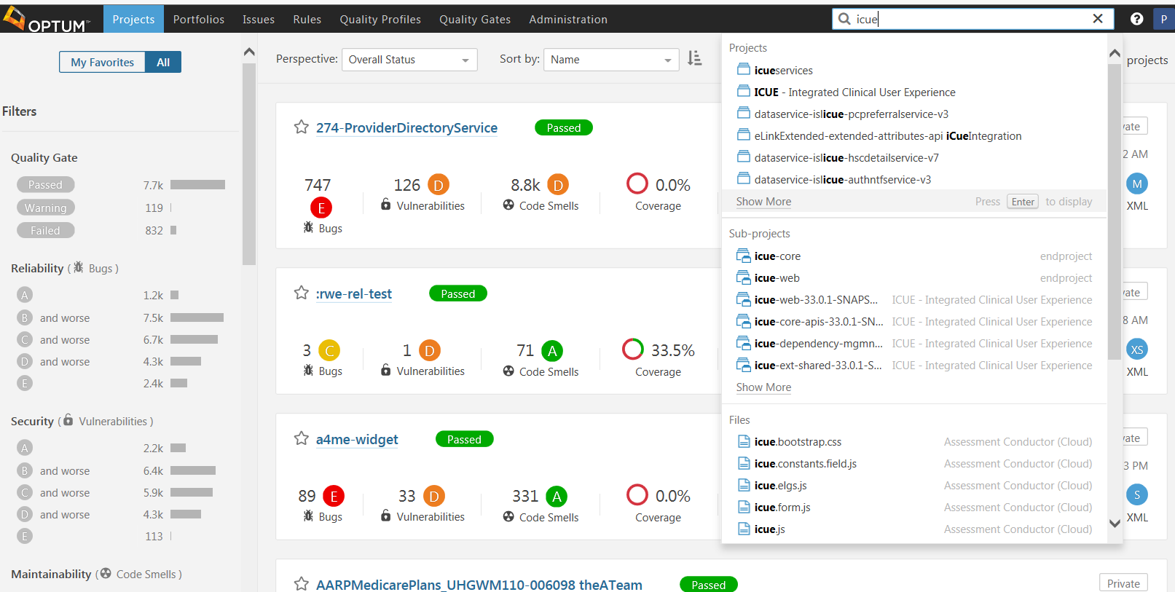
Sonarqube Dashboard (continued)
Locate & select the “ICUE” application

Slide 14
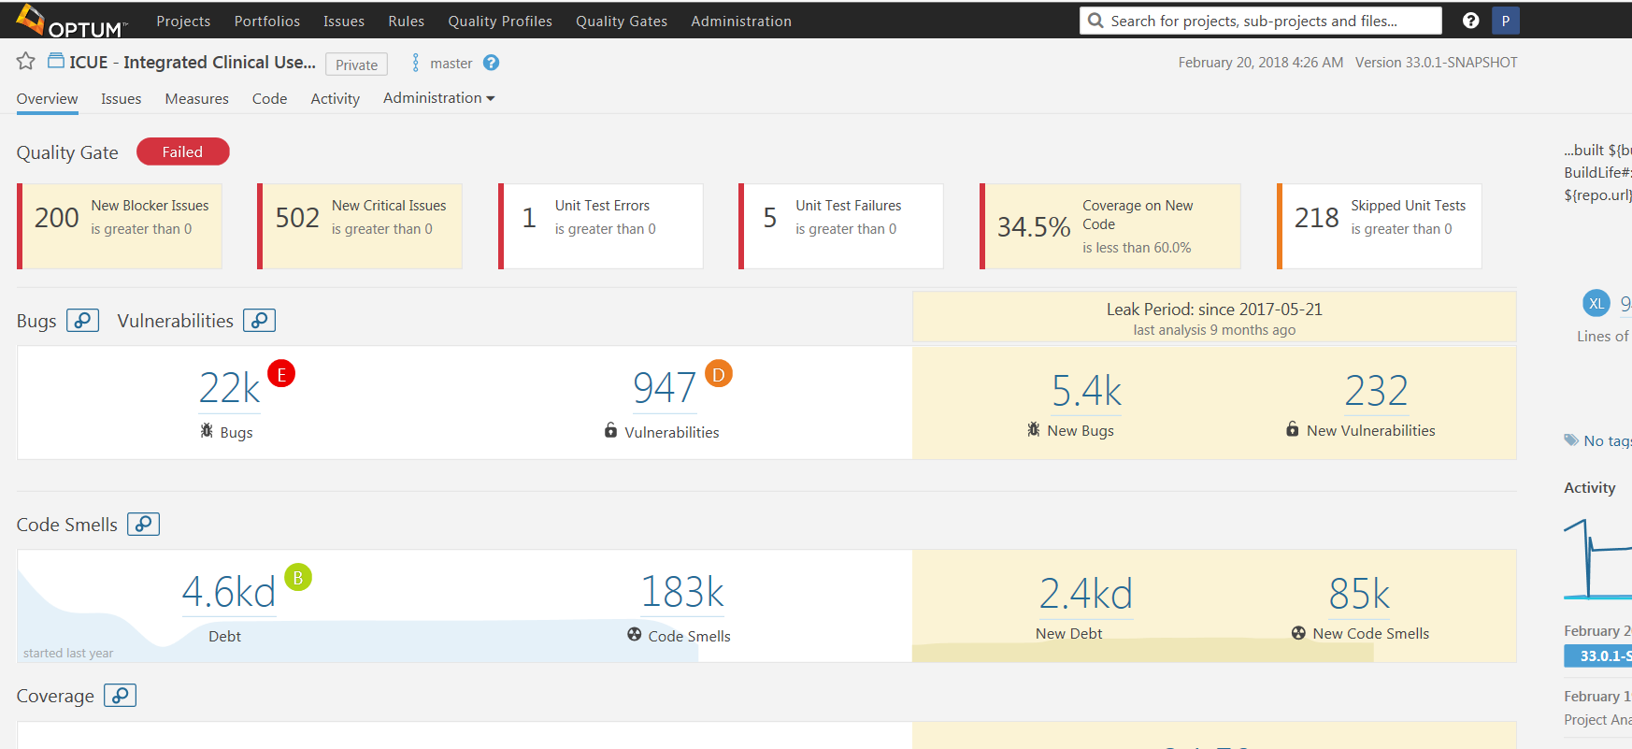
Sonarqube Dashboard (continued)
Home page for selected application
Shows reason for failed scan
3otal Issues counts
New counts since baseline

Slide 15
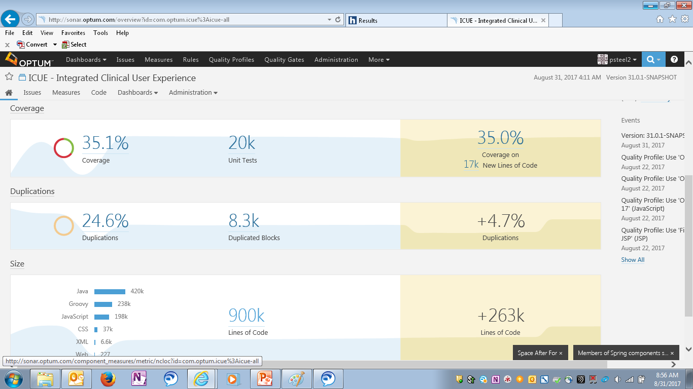
Sonarqube Dashboard (continued)
Coverage section shows Lines of code covered during testing
Duplications section shows Lines of duplicated code, which goes to maintainability
Size section reflects maintainability and identifies technology base

Slide 16
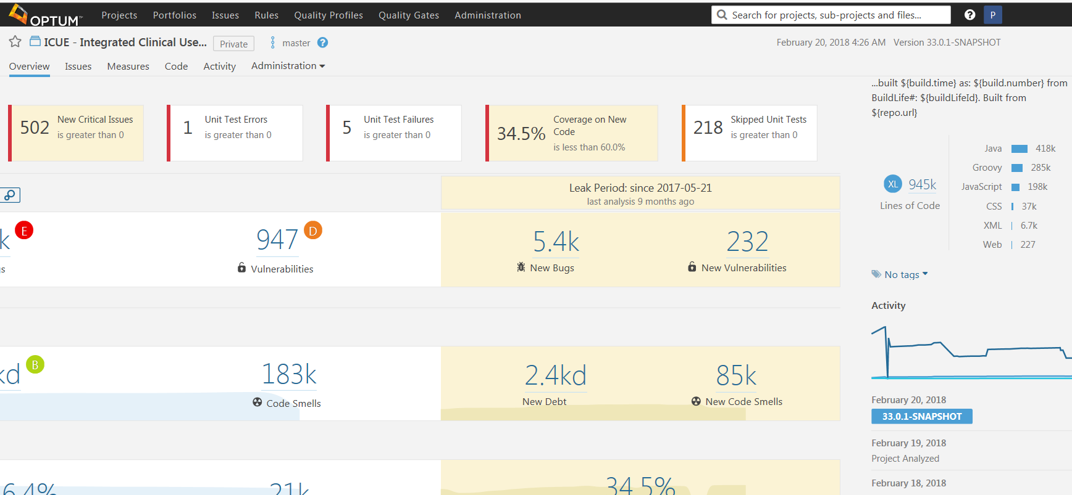
Sonarqube Dashboard (continued)
Lines of Code by Technology
Events shows the history of scan activity

Slide 17
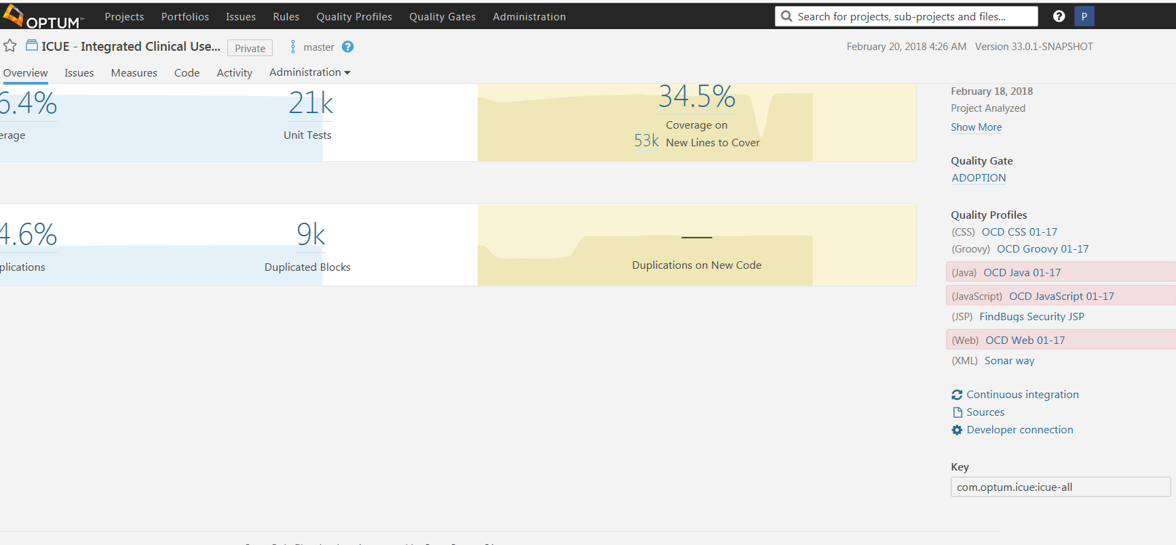
Sonarqube Dashboard (continued)
To look at specific issues and format of rules, click Issues in the bar above
Current Quality Gate
List of Quality Profiles used for each technology
External Links
Key (The applications unique identifier)

Slide 18
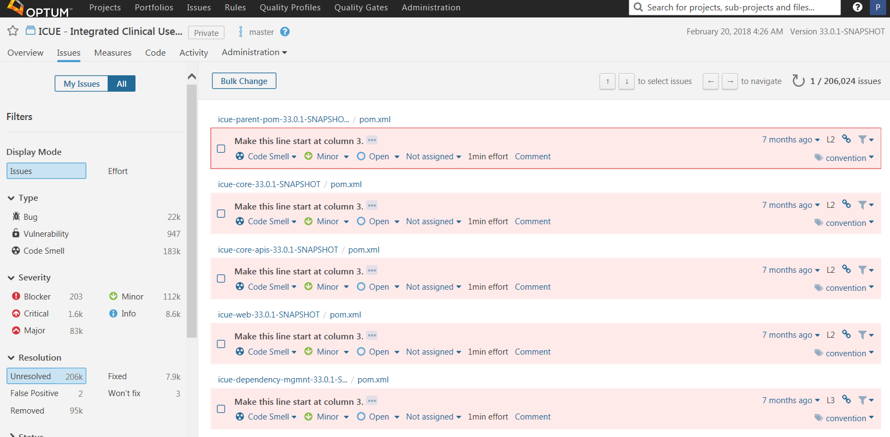
Sonarqube Dashboard (continued)
Filtering - used to identify subset of issues
Click the “…” to see issue related information
The specific Issues displayed are based on filtering criteria

Slide 19
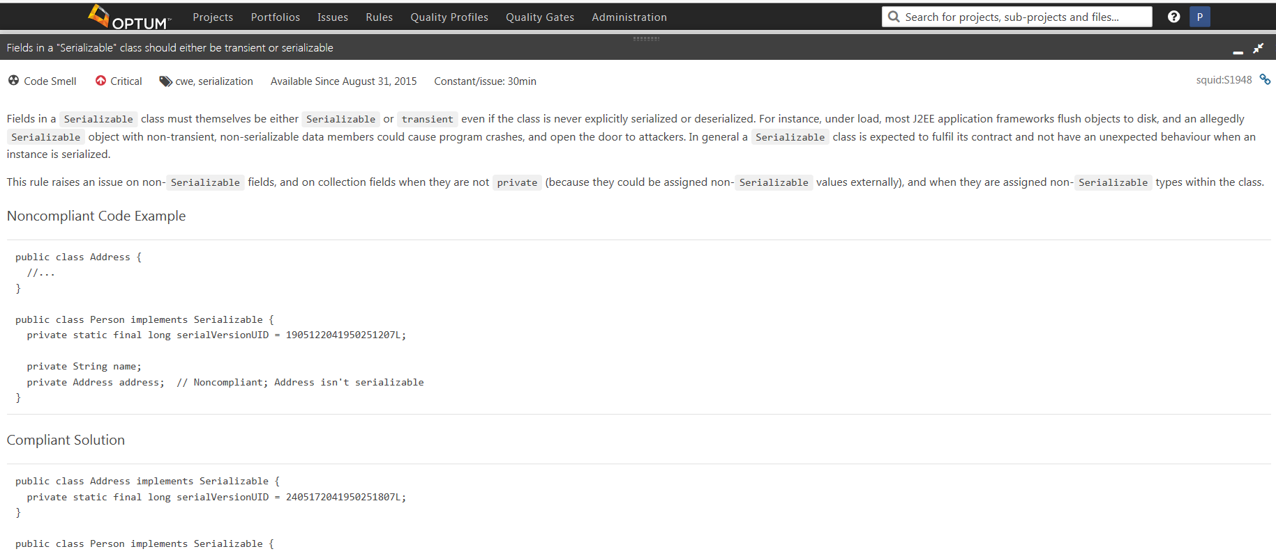
Sonarqube Dashboard (continued)
Expands to show rule explanation, why it’s important, and provides examples

Slide 20
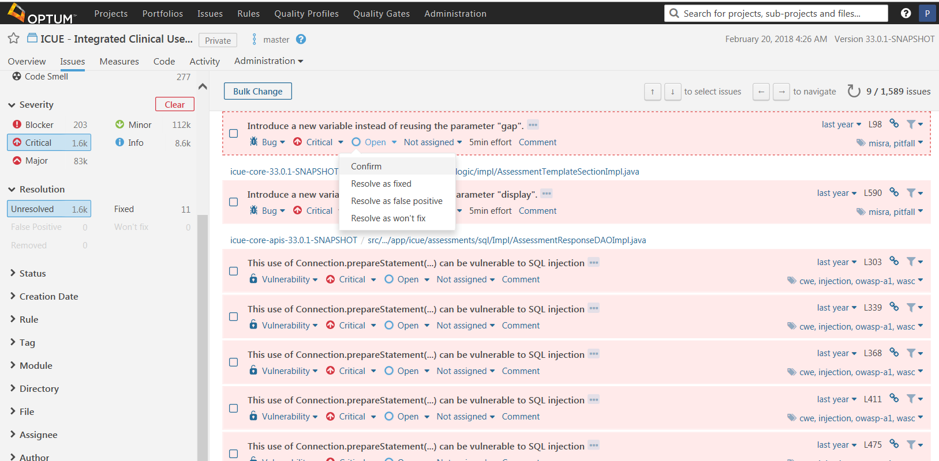
Sonarqube Dashboard (continued)
Clicking “Open” drops down a list of statuses you can assign to the issue.
1Current assignment can be changed by clicking the dropdown arrow.
Click on the Error Description” to see related source code

Slide 21
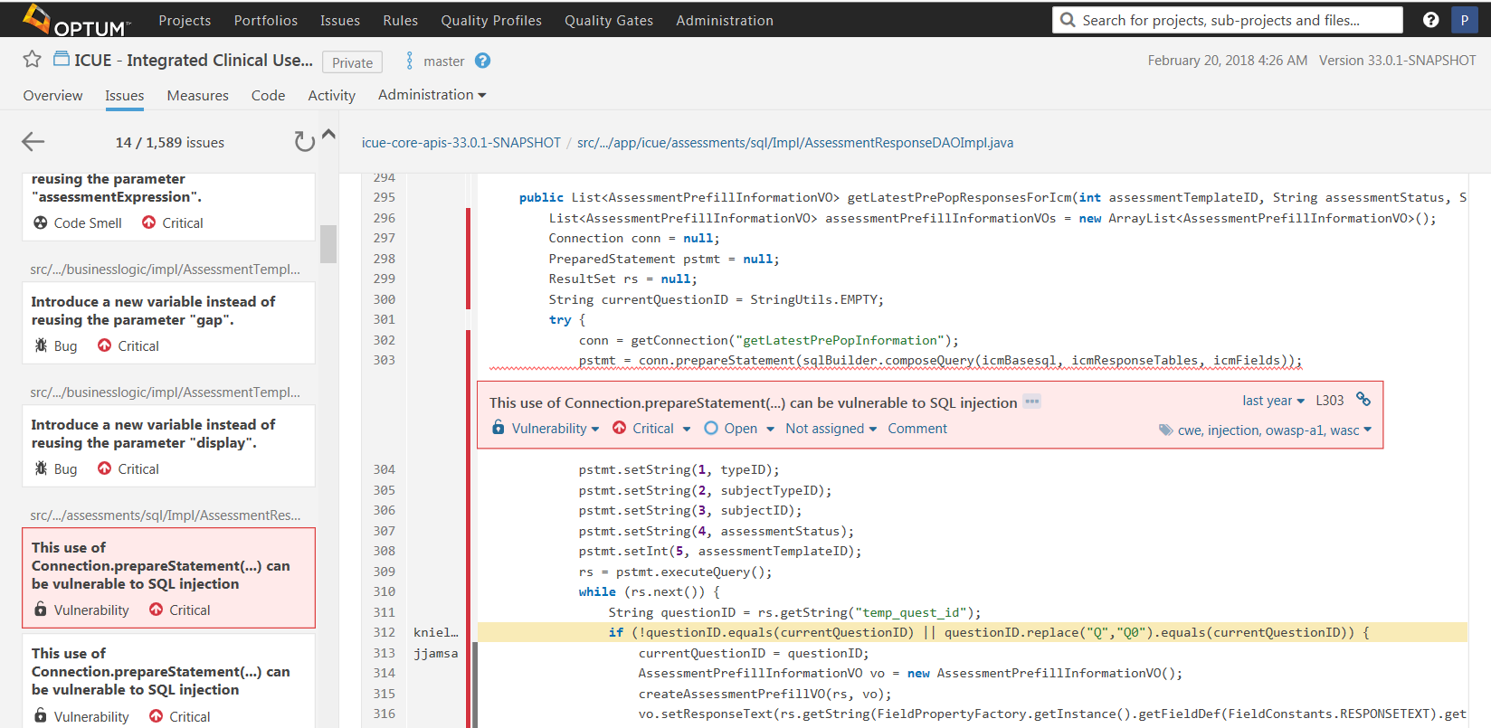
Sonarqube Dashboard (continued)
Click link to return to this applications issues list
Source code is displayed and the specific lines of code highlighted
Scroll to navigate to othe issues
Bars are used to indicate Coverage, Duplicate Lines, etc. Hover over line to see type

Slide 22
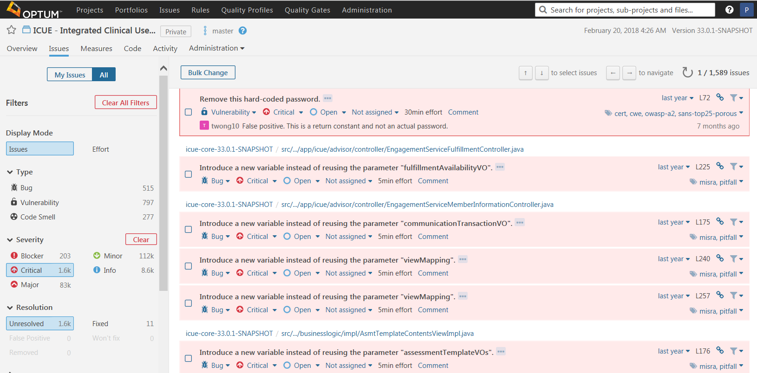
Sonarqube Dashboard (continued)
Click “Bulk Change” button.
Use filtering to create subset of issues to apply a bulk change

Slide 23
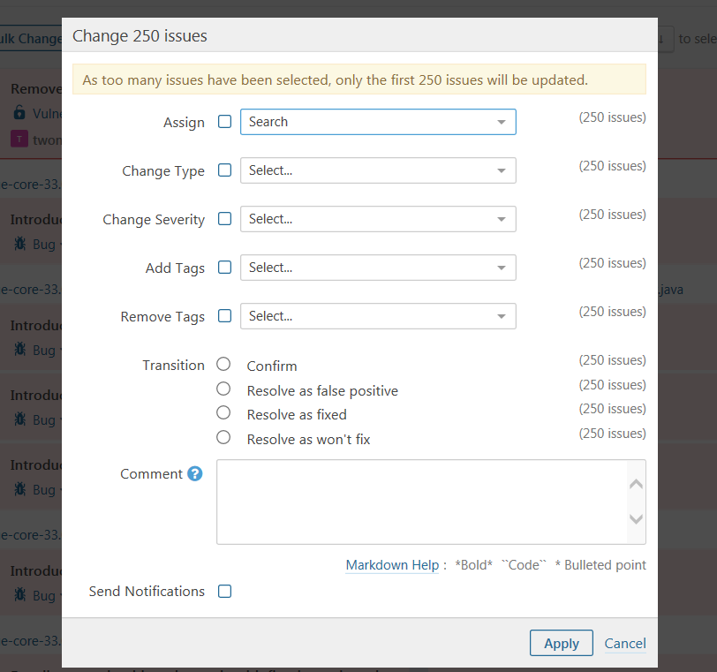
Sonarqube Dashboard (continued)
Fill in or select the type of bulk change you want to make and click “Apply”

Slide 24
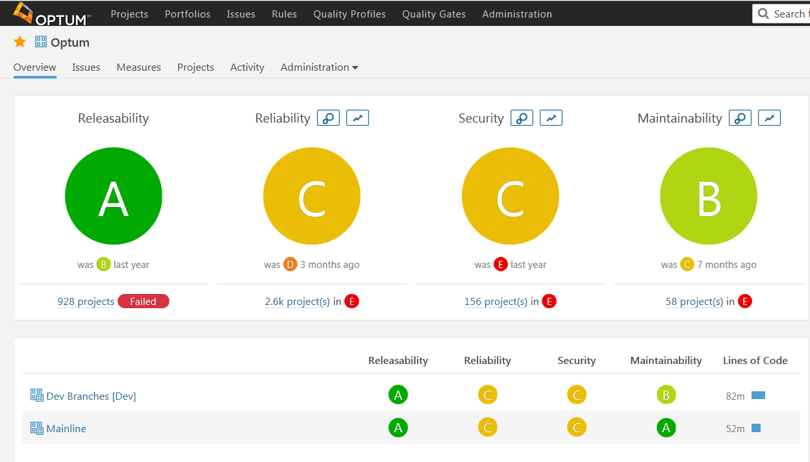
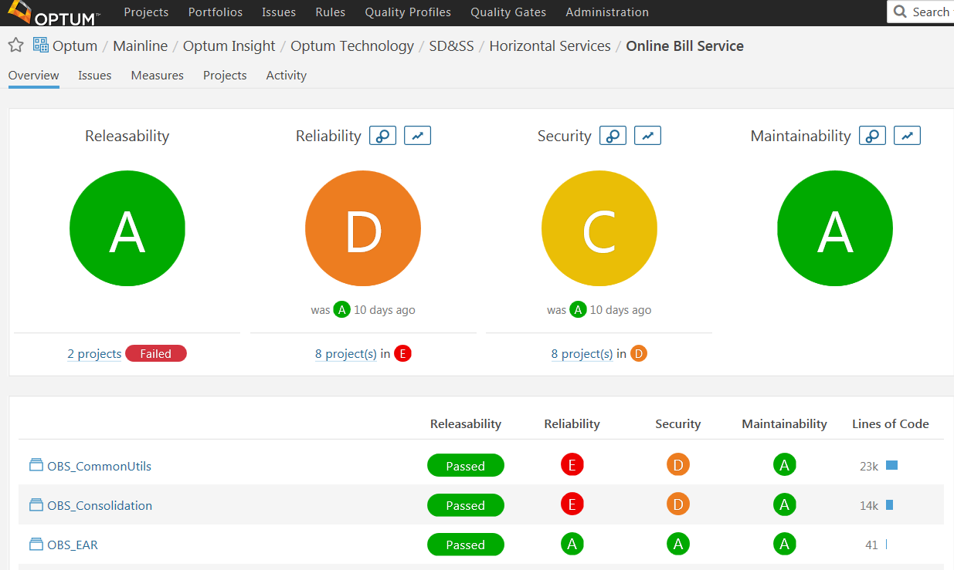
Portfolios
Cookie crumbs show the path of your drill-down
Drill down to the project/application level
At the Optum level we have Mainline and Dev Branches

Slide 25
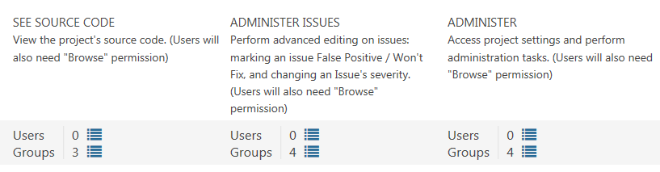
Permissions managed by MS-groups
Permissions are managed through the use of two (or three) MS-Groups. One for developers and then one or two for Admins.
Developer’s ms-group enables your team to view Source Code in the tool
Administer ms-group(s) allows team-leads and mangers the ability to set issue statuses and to manage SQ projects/applications.

Slide 26
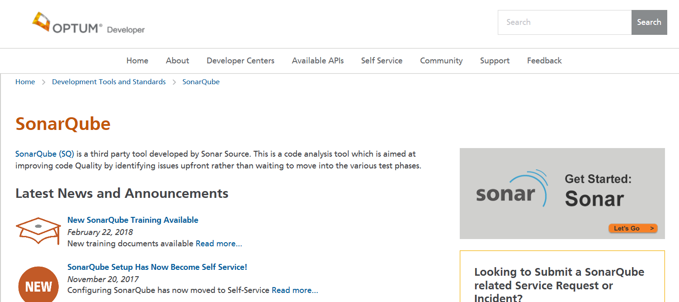
Self Service – Getting Started
SonarQube webpage in Optum Developer: https://www.optumdeveloper.com/content/odv-optumdev/optum-developer/en/development-tools-and-standards/sonarqube.html
Self-Service Sonarqube Configuration

Slide 27
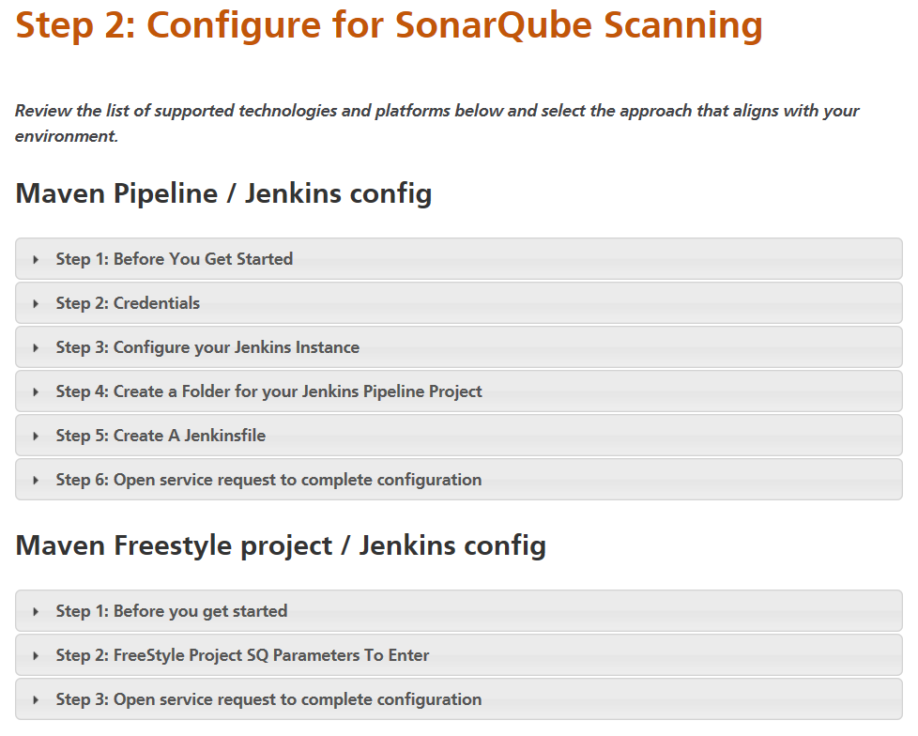
Self Service – Get Configured
Maven Pipeline / Jenkins
Maven Freestyle project / Jenkins
Maven Project / Jenkins
TFS VNext Version / .Net
TFS Non VNext Version / .Net
.Net / C# / Jenkins
Mainframe / Jenkins

Slide 28
Useful Links
SonarQube webpage in Optum Developer: https://www.optumdeveloper.com/content/odv-optumdev/optum-developer/en/development-tools-and-standards/sonarqube.html
The Hub: results for SonarQube : https://hub.uhg.com/Pages/Results.aspx?k=sonarqube&Country=USA
SonarQube Concepts: https://docs.sonarqube.org/display/SONAR/Concepts#Concepts-Architecture

Slide 29
Questions
Questions ?

